Slide 1
UNIT III Synchronization in DS
Lecture-13

Slide 2
Introduction
In single CPU systems, critical regions, mutual exclusion, and other synchronization problems are generally solved using methods such as semaphore and monitors.
These methods are not well suited to use in distributed systems because they invariably rely on the existence of shared memory.
For example, two processes that are interacting using a semaphore must both be able to access the semaphore.
If they are running on the same machine, they can share the semaphore by having it stored in the kernel, and execute system calls to access it.
If, however, they are running on different machines, this method no longer works, and other techniques are needed.
Even the partial ordering of the events, i.e., whether Event A happened before or after event B in the DS requires additional techniques.

Slide 3
Clock Synchronization
Synchronization in DS is more complicated than in Centralized ones because the DS have to use distributed algorithms (DAs).
In general, DAs have the following properties:
1. The relevent information is scattered among multiple machines.
2. Processes make decisions based only on local information.
3. A single point of failure in the system should be avoided.
4. No common clock or other precise global time source exists.
The first three points say that it is unacceptable to collect all the information in a single place for processing.
The last point deals with common clock: In a centralized system, time is unambigious.
When a process wants to know the time, it makes the system call and the kernel tells it.
Ex: Consider the Unix make program.

Slide 4
Cont..
The operation of the Unix make file is as follows:
When the programmer has finished changing all the source files, he starts make, which examines the times at which all the source and object files were last modified.
If the source file input.c has time 2151 and the corresponding object file input.o has time 2150, make knows that input.c has been changed since input.o was created, and thus input.c must be recompiled.
On the other hand, if output.c has time 2144 and output.o has time 2145, no compilation is needed here. Thus, make goes through all the source files to find out which ones need to be recompiled and calls the compiler to recompile them.
Now imagine that what could happen in a DS in which there is no global agreement on time.
Suppose that output.o has time 2144, and shortly thereafter output.c is modified but is assigned time 2143 because the clock on its machine is slightly slow.
Make will not call the compiler to recompile output.c.

Slide 5
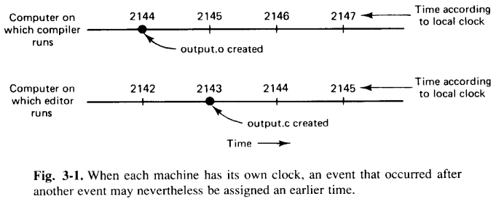
Cont..
The resulting executable binary program will then contain a mixture of object files from the old sources and the new sources.
As a result, the program will not execute and the programmer will never understand what is wrong with the code.
Question: Is it possible to synchronize all the clocks in a DS?

Slide 6
Logical Clocks
Nearly all computers have a circuit for keeping track of time.
Despite the widespread use of the word “clock” to refer to these devices, they are not actually clocks in the usual sense. A more accurate term would be a "timer".
A computer timer is usually a precisely machined quartz crystal (QC).
Quartz crystals are used in computers to create a processor clock that coordinates the computer's operations.
When kept under tension, QC oscillate at a well-defined frequency that depends on the kind of crystal, how it is cut, and the amount of tension.
Associated with each crystal are two registers: a “counter” and a “holding register”.
Each oscillation of the crystal decrements the counter by one. When the counter gets to zero, an interrupt is generated and the counter is reloade from the holding register.
Each interrupt is called one clock tick.

Slide 7
Cont..
With a single computer and a single clock, it does not matter much if this clock is off by a small amount, since all processes on the machine use the same clock they will still be internally consistent.
For example, if the file input.c has time 2151 and file input.o has time 2150, make will recompile the source file, even if the clock is off by 2 units and the two times are 2153 and 2152 respectively. All that really matters are the relative times.
As soon as multiple CPUs are introduced, each with its own clock, the situation changes.
In practice, when a system has n computers, all n crystals will run at slightly different rates, causing the clock gradually to get out of sync and give different values when read out.
This difference in the time values is called clock skew.
As a consequence of this clock skew, programs that expect the time associated with a file, object, process, or message to be correct can fail.
This brings us back to our original question, whether it is possible to synchronize all the clocks to produce a single, unambiguous time standard.

Slide 8
Cont..
Lamport pointed out that if two processes do not interact, it is not necessary that their clock be synchronized.
Furthermore, he pointed out that what usually matters is not all processes agree on exactly what time it is, rather, they agree on the order in which events occur.
For many purposes, it is sufficient that all machines agree on the same time. It is not essential that this time also agree with the real time.
That is, for certain class of algorithms, it is the internal consistency of the clocks that matters, not whether they are particularly close to the real time.
These types of clocks are known as Logical Clocks.
When the additional constraint is present that the clocks must not only be the same, but also must not deviate from the real time by more than a certain amount, the clocks are called Physical Clocks.

Slide 9
Cont..
To synchronize logical clocks, Lamport defined a relation called “happens-before”.
The expression a --> b is read “a happens before b” and meanse that all processes agree that first event a occurs, then afterward, event b occurs.
The happens-before relation can be observed in two situations:
1. If a and b are the events in same process, and a occurs before b, then a --> b is true.
2. If a is the event of a message being sent by one process, and b is the event of the message being received by another process, then a --> b is also true.
Happens-before is a transitive relation, so if :
a --> b and b --> c, then a --> c.
It two events, x and y, happen in different processes that do not exchange messages, then
x --> y is not true and neither is y --> x. These events are said to be “concurrent”, which simply meanse that nothing can be said about the order of the events.

Slide 10
Cont..
We need a way of measuring time such that for every event a, we can assign it a time value C(a) on which all processes agree. These time values must have the properties that if a → b, then C(a) → C(b).
We can now rewrite points 1 and 2 (shown in previous slide) as:
If a and b are two events within the same process and a occurs before b, then
C(a) < C(b).
Similarly, if a is the event of a message being sent by one process, and b is the event of the message being received by another process, then C(a) and C(b) must be assigned in such a way that everyone agrees on the values of C(a) and C(b), with C(a) < C(b).
In addition, the clock time, C, must always go forward (increasing), never backward (decreasing).
Corrections to time can be made by adding a positive value, never by subtracting one.

Slide 11
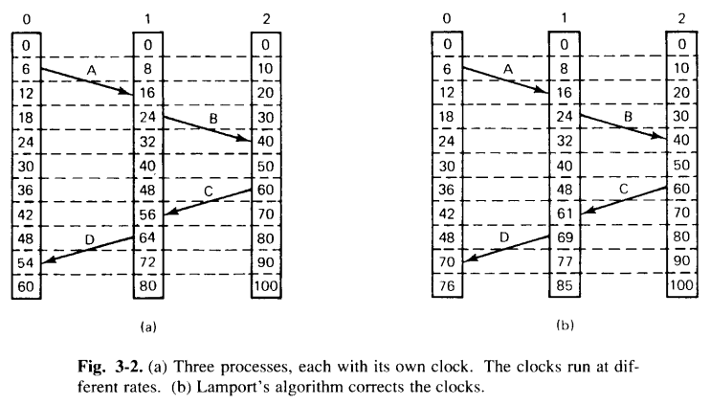
Cont..
Lamport’s algorithm for assigning times to events:
Consider the three processes shown in Fig. 3-2(a).

Slide 12
Cont..
The processes run on different machines, each with its own clock, running at its own speed.
As can be seen from the figure, when the clock has ticked 6 times in Process 0, it has ticked 8 times in Process 1, and 10 times in Process 2.
Each clock runs at a constant rate, but the rates are different due to differences in the crystals.
At time 6, Process 0 sends message A to Process 1.
The clock in Process 1 reads 16 when message A arrives at Process 1.
If the message carries the starting time, 6, in it, Process 1 will conclude that it took 10 ticks to make the journey. This value is possible.
According to this reasoning, message B from 1 to 2 takes 16 ticks, again a possible value.
Now, message C from 2 to 1 leaves at 60 and arrives at 56. Similarly, message D from 1 to 0 leaves at 64 and arrives at 54. These values are clearly impossible.
This situation must be prevented.

Slide 13
Cont..
Lamport has given a solution to this problem that follows directly from the happened-before relation.
Since C left at 60, it must arrives at 61 or later. Therefore, each message carries the sending time, according to the sender’s clock.
When a message arrives and the receiver’s clock show a value prior to the time the message was sent, the receiver fast forwards its clock to be one more than the sending time.
In Fig. 3-2(b) we see that C now arrives at 61. Similarly, D arrives at 70.
Additional points to the Lamport’s solution:
1. If a process sends or receives two messages in quick succession, it must advance its clock by (at least) one tick in between them.
2. No two events ever occur at exactly the same time.
Thus, if events happen in Process 1 and 2, both with time 40, the former becomes 40.1 and the latter becomes 40.2.

Slide 14
Cont..
Using this method, we now have a way to assign time to all events in a DS subject to the following conditions:
1. If a happens before b in the same process then C(a) < C(b).
2. If a and b represent the sending and receiving of a message respectively then C(a) < C(b).
3. For all events a and b, C(a) ≠ C(b).

Slide 15
Physical Clocks
Importance of Physical Clocks:
While Lamport's algorithm provides an unambiguous ordering of events, the assigned time values do not necessarily reflect the actual occurrence times.
In systems where real-time accuracy is critical, such as in real-time systems, external physical clocks are essential.
Having multiple physical clocks enhances efficiency and redundancy, but it introduces two significant challenges:
Synchronizing these clocks with real-world time.
Synchronizing the clocks with each other.
Measurement of Time:
Accurate time measurement is complex. Historically, time measurement was astronomical, based on the solar day—the interval between two consecutive transits of the Sun.
The event of the Sun reaching its highest apparent point in the sky is called the transit of the Sun.
A solar second was defined as exactly 1/86400th of a solar day.

Slide 16
Cont..
Variations in Earth's Rotation:
In the 1940s, it was discovered that the Earth's rotation period is not constant due to tidal friction and atmospheric drag.
Geological studies suggest that 300 million years ago, there were about 400 days in a year, indicating that the Earth's rotation has slowed down.
Additionally, short-term variations in day length occur due to turbulence in the Earth's core.
These revelations led astronomers to compute the length of the day by measuring a large number of days and taking the average before dividing by 86400.
The resulting quantity was called the mean solar second.
With the invention of the atomic clock in 1948, timekeeping became more convinient by counting transitions of the cesium 133 atom.
An atomic clock is a clock that measures time by monitoring the resonant frequency of atoms. It is based on atoms having different energy levels.
Cesium 133 is a non-radioactive isotope of cesium, a silver-gold metal that melts just above room temperature. It is used in atomic clocks and as a scientific time standard.

Slide 17
Cont..
The physicists took over the job of timekeeping from astronomers, and defined the second to be the time it takes the cesium 133 atom to make exactly 9,192,631,770 transitions, making the atomic second equal to the mean solar second at the time of its introduction.
Approximately 50 laboratories worldwide use cesium 133 clocks to measure time.
These laboratories report their clock ticks to the Bureau International de l'Heure (BIH) in Paris, which averages them to produce International Atomic Time (TAI).
TAI is the mean number of cesium 133 clock ticks since January 1, 1958, divided by 9,192,631,770.
Due to the Earth's slowing rotation, 86,400 TAI seconds are now about 3 milliseconds shorter than a mean solar day.
To prevent discrepancies, BIH introduces leap seconds when the difference between TAI and solar time reaches 800 milliseconds.
This adjustment maintains synchronization with the sun's apparent motion, resulting in Universal Coordinated Time (UTC), the modern civil timekeeping standard.

Slide 18
Cont..
UTC is disseminated through various means, including shortwave radio stations like WWV in Fort Collins, Colorado, and MSF in Rugby, Warwickshire.
(WWV is a shortwave radio station run by the National Institute of Standards and Technology (NIST) in Fort Collins, Colorado. It broadcasts official U.S. government time and frequency information 24 hours a day, 7 days a week to millions of listeners worldwide).
These broadcasts offer UTC with an accuracy of about ±1 millisecond, though atmospheric conditions can reduce practical accuracy to ±10 milliseconds.
Satellites also provide UTC services with high accuracy, requiring precise knowledge of sender-receiver positions to account for signal propagation delays.

